Slide 1
Restaurant Recommendation system Pune India
DatA Science capstone Project
-Prajol Sethi

Slide 2
Introduction
To make a restaurant recommendation system for a stakeholder to invest a new food business in Pune using the insights of best place to invest and market depending on college that is student centric crowd.
Problem Background
Pune, also known as Poona , is a city in the Indian State of Maharashtra and the eighth most populous city in India, with an estimated population of about 7.4 million as of 2020.It has been ranked as "The most livable city in India" several times, Pune is one of the cleanest and greenest city in the country . It is known for various architecture build during the Marathas and Peshwas Empire ,surrounded by hills . Not just this but the most important aspect Pune is a city of students coming from all over the world to learn various disciplines from most prestigious colleges .That is why , its also known as the Oxford of East.

Slide 3
Problem Description
So keeping this points in mind, Pune becomes a large market for food industry ,as it is surrounded more by the youth population making it easy for Restaurants to make as good profit. As youngster love to explore new corners of city and restaurants too. We would be able to answer the following questions from this recommendation :
Which location around a college will be best to invest business according to clustering results ?
Which locations around a college will be best to market and pull the crowd ?
Which are some top niche colleges of Pune ?
What are the different categories of food being served ?

Slide 4
Target Audience
Entrepreneurs and small-scale businessmen/women interested in the food/ snacks industry, aiming at the student demographic.

Slide 5
Data
To find a solution to the questions and build a recommender model, we need data and lots of data. Data can answer question which are unimaginable and non answerable by humans because humans do not have the tendency to analyse such large dataset and produce analtics to find a solutions.
We need a list of the most popular institutes in Pune. Their latitude and longitude will be calculated using Geopy Nominatim (a Python Library). This data can be found on Wikipedia. For instance: https://en.wikipedia.org/wiki/List_of_educational_institutions_in_Pune
Then we can use the FourSquare API to find the number of eateries in a 1km radius around each institute. The API will provide us with Postal Code, Neighborhood, Venue, Venue Summary and Venue Category.
We can also use the FourSquare API to find all food related categories that we will filter.
Selecting relevant venues (food related only). The institutes with least number of eateries around them would be the best places to start a food stall/ restaurant. (supply and demand)
Clustering the eateries to find the colleges with least competition around them.
Using clustering result to find which place will be best for marketing and advertisement

Slide 6
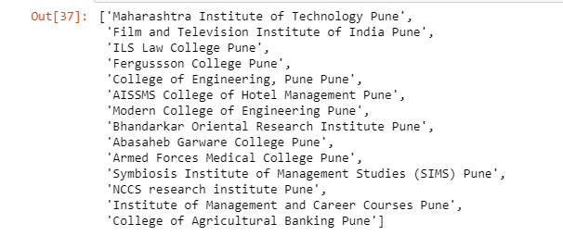
Data Set

Slide 7
Methodology:
Collect a list of educational institutes in Pune .
Using Nominatim library and Open Map tool to get latitudes and longitudes of Institutes.
Use of Foursquare API to filter required food categories.
Devised a function to get a categories of given venue data.
Analyzed the no of eateries near a particular institute.
Using clustering inorder to get more clear data .
Thereby clustering institutes and then integrating eateries clustering data .
Using random function to get a better differentiation in clusters
Using itertools library to get cluster size and counts
Find the smallest and largest cluster to get the required analysis

Slide 8
Building Project Restaurant Recommendation System

Slide 9
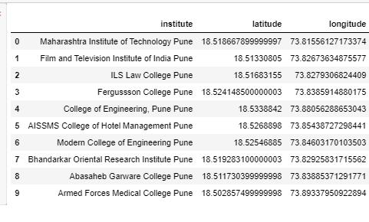
Data Frame for Institutes with location

Slide 10
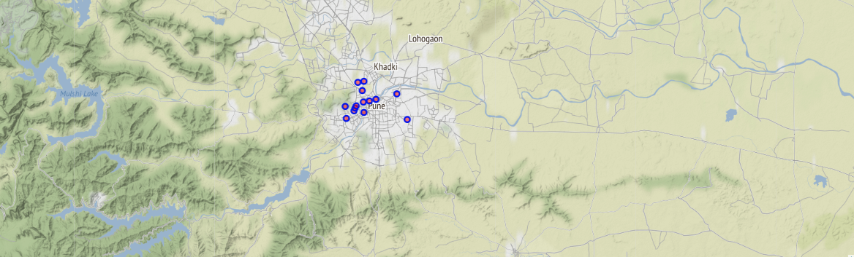
Plotting the Institute of on a map of Pune,India

Slide 11
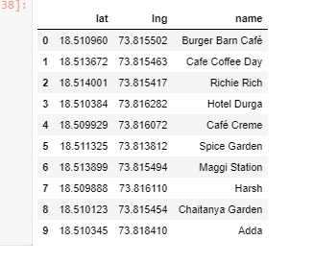
Nearby Eateries Location

Slide 12
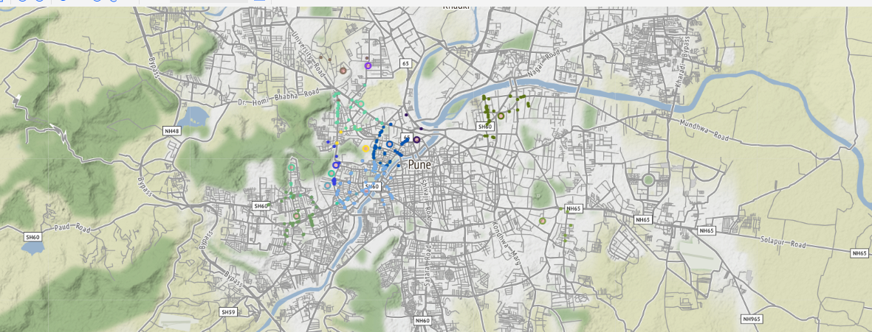
Plotting Eateries

Slide 13
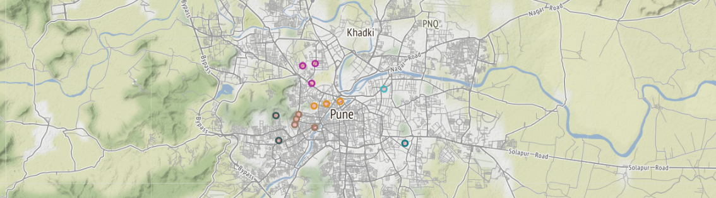
Plotting Clustered Eateries

Slide 14
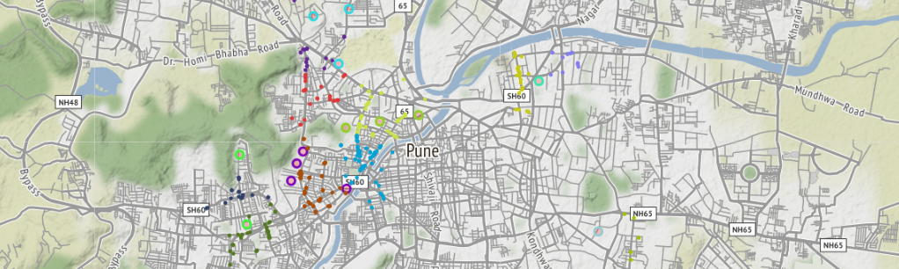
Clustering Educational Institute with nearby eateries

Slide 15
Analysis and Obeservation
Cluster 4: College of Engineering Pune has very few eateries around it. It is a well reputed college in Pune, infact the top college and has a large student population.
A good eatery aimed at students, or even at the general public as it connect to the most premium sector of Pune that is JM Road. Thereby,would do well here due to sheer lack of competition in the vicinity.
Hence we find that the best place for a food shop aimed at student crowd in general will be near College of Engineering COEP, ShivajiNagar,Pune

Slide 16
Continued..
2 nd result
We also find that 3 clusters have more than 50 eateries near them.
These could be great localities to advertise an upcoming new fast food shop or restaurant.
That is :
Maharashtra Institute of Technology ,Kothrud, Pune
Fergussson College, FC Road, Pune
Modern College of Engineering,Model Colony, Pune
Thereby this area would be the best sectors for marketing as it consists of the most cream crowd well established colleges and restuarant there by will be helpful to attract new customers.
Last observation
As mentioned the three colleges have highest clusters so it can be predicted that they are the niche college in Pune
Thankyou

